Slide 1
Intended Video Generation
using Conditional Video GAN
2012210046 박지홍
2013210017 정상헌
2013210023 김승윤

Slide 2
Contents
What we are trying to do?
Dataset
Video GAN model
Conditional GAN model
Our Model
Results
Q & A

Slide 3
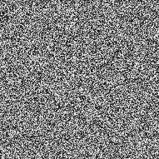
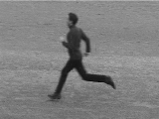
What we are trying to do?
Video with running
+
Running

Slide 4
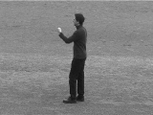
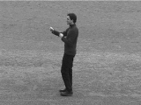
Dataset
32 Images -> 3093 Videos
Label
- Boxing
- Handwaving
- Handclapping
- Running
- Jogging
- Walking

Slide 5
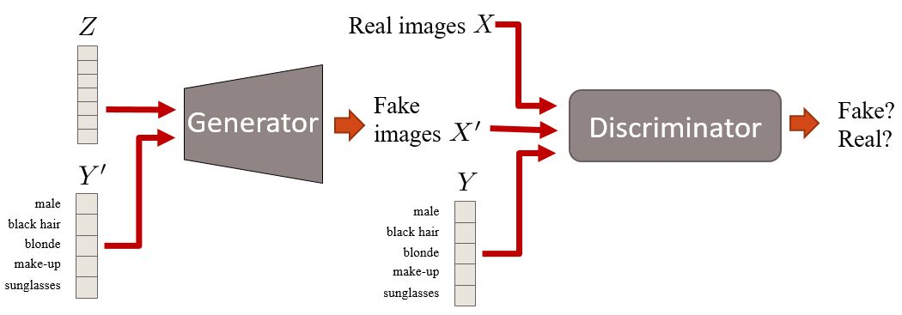
Conditional GAN Model
Conditional Generative Adversarial Nets Mehdi Mirza, Simon Osindero (Submitted on 6 Nov 2014)
Notes:
기존 GAN model에서 Noise Z 와 Condition Y concat하여 원하는 이미지를 생성

Slide 6
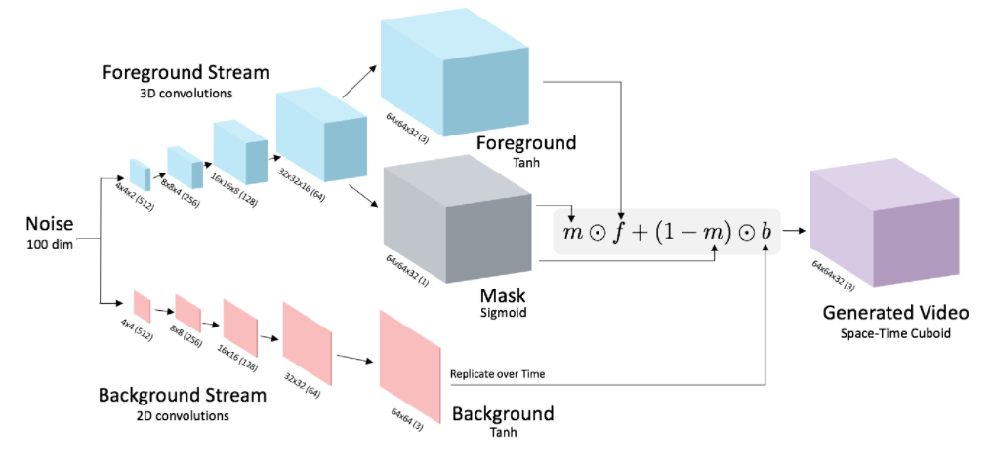
Video GAN Model
Generating Videos with Scene Dynamics by Carl Vondrick, Hamed Pirsiavash, Antonio Torralb

Slide 7
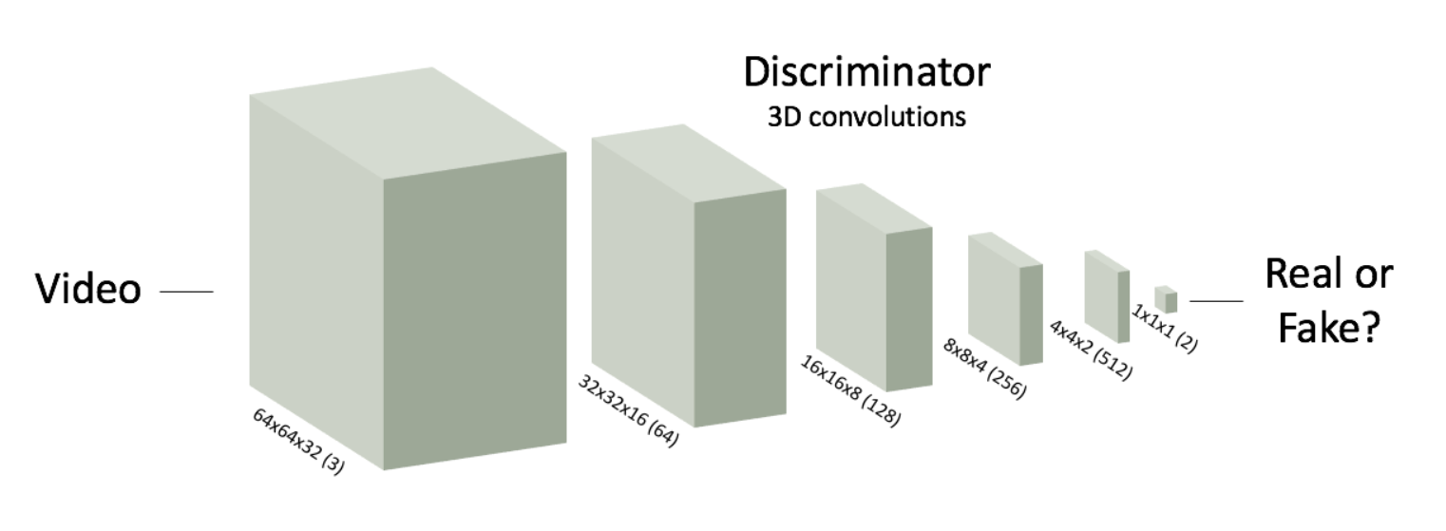
Video GAN Model
Generating Videos with Scene Dynamics by Carl Vondrick, Hamed Pirsiavash, Antonio Torralb

Slide 8
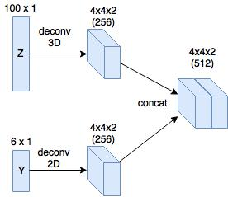
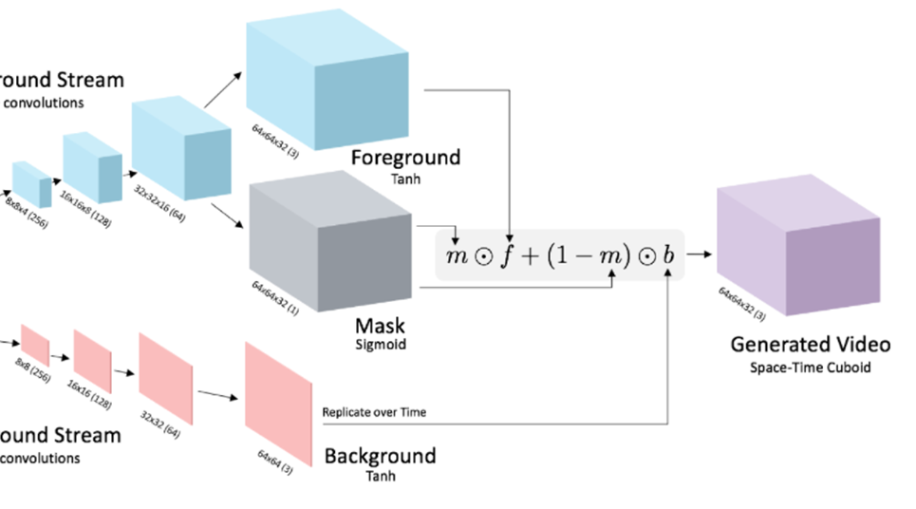
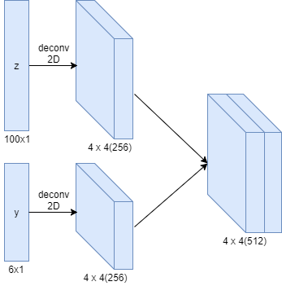
Conditional Video GAN Model

Slide 9
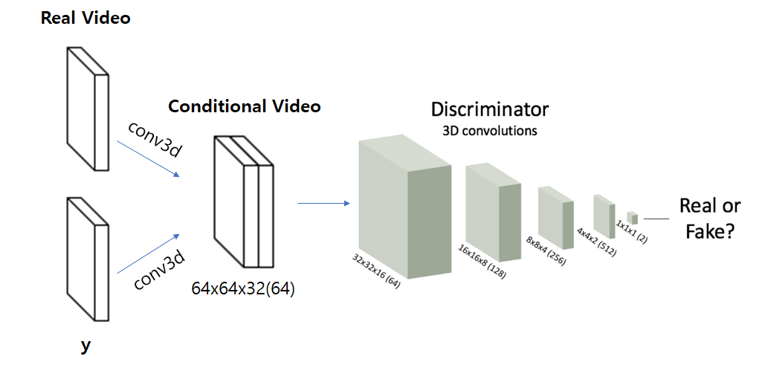
Conditional Video GAN Model

Slide 10
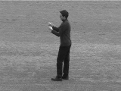
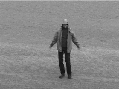
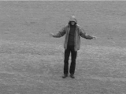
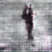
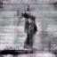
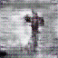
Result
 | Boxing | Hand waving | Hand clapping
Real Video
Fake Video

Slide 11
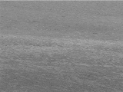
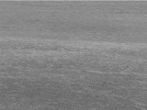
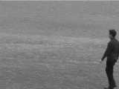
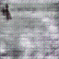
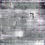
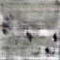
Result
 | Running | Jogging | Walking
Real Video
Fake Video

Slide 12
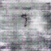
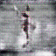
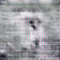
Result
 | Boxing + Running | Handwaving + Jogging | Handclapping + Walking
Fake Video

Slide 13
“감사합니다”
Q & A

